Slide 1
COVID 19 Pandemic Response⎼India
NCDC
23/04/2020

Slide 2
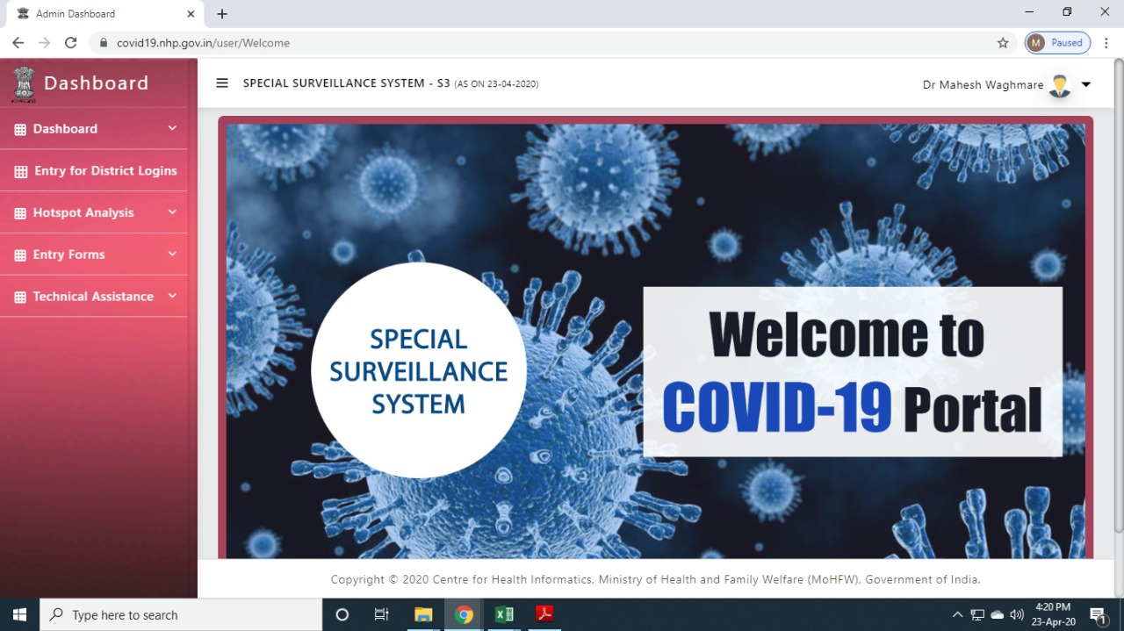
COVID-19 Surveillance and Response in India
IDSP - Surveillance and response−
Decentralized reporting from 37 states and 734 districts
IT enabled near real time data capture
SSS dashboard developed
Epidemic Intelligence and data analysis support to States
Effective coordination
Linked to hotspot identification and cluster containment by States
Monitoring response interventions

Slide 3
States - District level Implementation framework COVID-19 Surveillance and Response
District − DM/ Collector
Affected and non- affected districts
House to house search
Quarantine & isolation
Logistics – dashboards, media
Coordination for sample collection
Linked to hotspot identification and cluster containment
Monitoring by PS/Health ministry/ CS/CMs
Central teams deployment

Slide 4
Community Surveillance through IDSP till 23-04-2020
Date | Cumulative under surveillance
23-01-2020 | 13
30-01-2020 | 1088
06-02-2020 | 6599
13-02-2020 | 17949
20-02-2020 | 20221
27-02-2020 | 23832
05-03-2020 | 29607
12-03-2020 | 38082
19-03-2020 | 90459
26-03-2020 | 267921
02-04-2020 | 571616
09-04-2020 | 659665
16-04-2020 | 775589
23-04-2020 | 945915

Slide 5
Community Surveillance through IDSP till 23-04-2020
Date | Cumulative under surveillance | Cases
23-01-2020 | 13 | 0
30-01-2020 | 1088 | 0
06-02-2020 | 6599 | 3
13-02-2020 | 17949 | 3
20-02-2020 | 20221 | 3
27-02-2020 | 23832 | 3
05-03-2020 | 29607 | 16
12-03-2020 | 38082 | 73
19-03-2020 | 90459 | 166
26-03-2020 | 267921 | 649
02-04-2020 | 571616 | 1965
09-04-2020 | 659665 | 5734
16-04-2020 | 775589 | 12252
23-04-2020 | 945915 | 21298

Slide 6
Data Driven Graded Government Policies Introduced

Slide 7
Slowdown in Doubling Rate after Countrywide Lockdown
Time Period of Lock Down | Cumulative Cases | 7 Day Doubling Time (Days)
Week 1 (24 – 30 March) | 1251 | 5.2
Week 2 (31 March– 6 April) | 4421 | 4.2
Week 3 (7 – 13 April) | 10363 | 6.0
Week 4 (14– 20 April) | 18601 | 8.6

